Slide 1
STOCK MARKET DATA ANALYSIS (P-199)
Under the guidance of :
Rajashekhar Sir & Pallavi Mam

Slide 2
Members of Group 5 :
Akshay Sathe
Nitesh Shinde
Rishwanth Skanda
Sonali Vardam
Anil Kumar Reddy
Madhu Atmakuru
Atharva Kulkarni

Slide 3
Objective :
Predict the Reliance Industries Stock Price for the next 30 days.
Split the last year into a test set- to build a model to predict stock price.
Forecast for next 30 days.

Slide 4
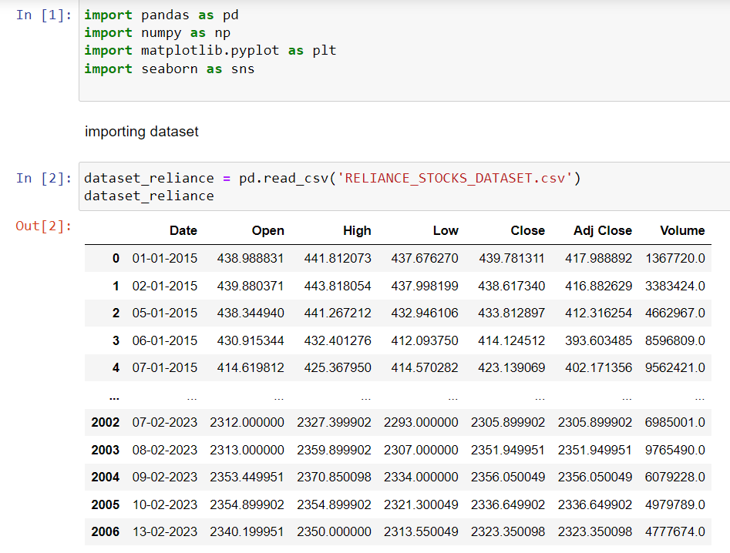
Step 1 : Download the dataset
The dataset has been downloaded from website –
https://finance.yahoo.com/quote/RELIANCE.NS/history/
Import the dataset in Jupyter notebook –

Slide 5
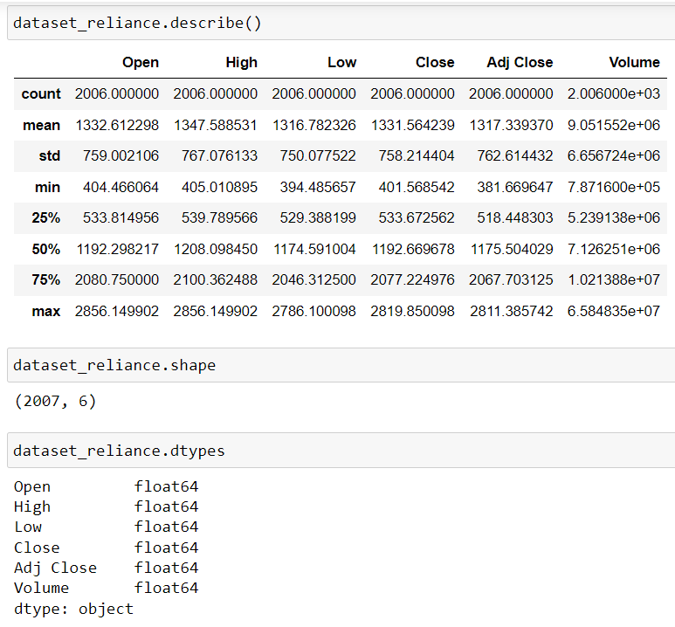
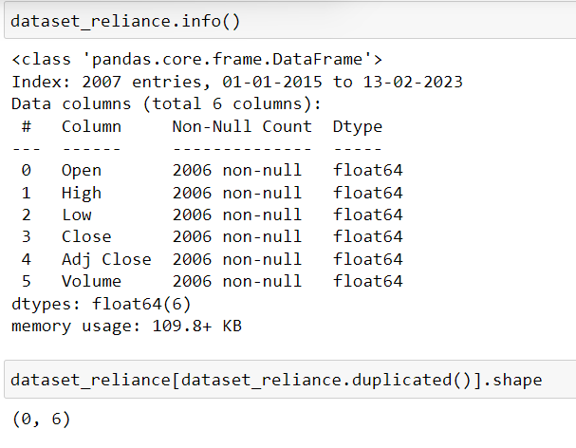

Slide 6
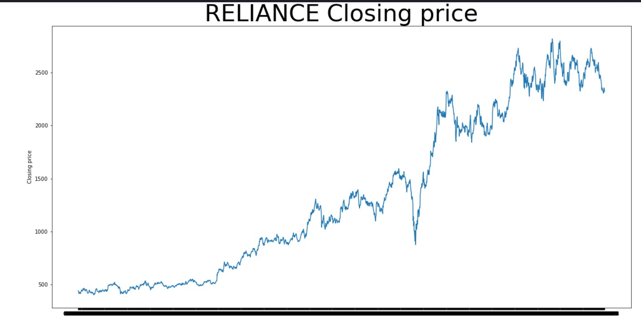
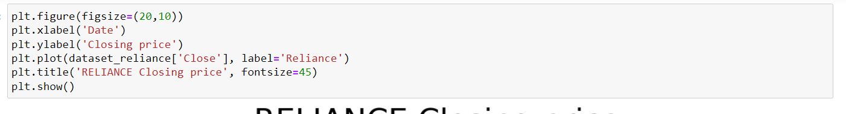

Slide 7
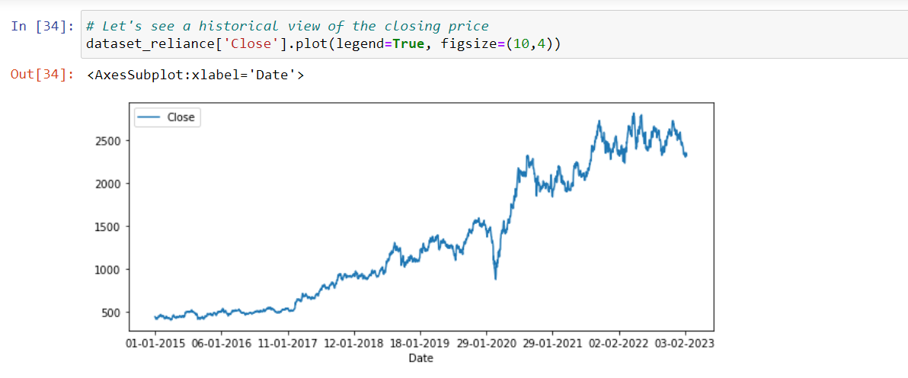
Historical view of closing price -

Slide 8
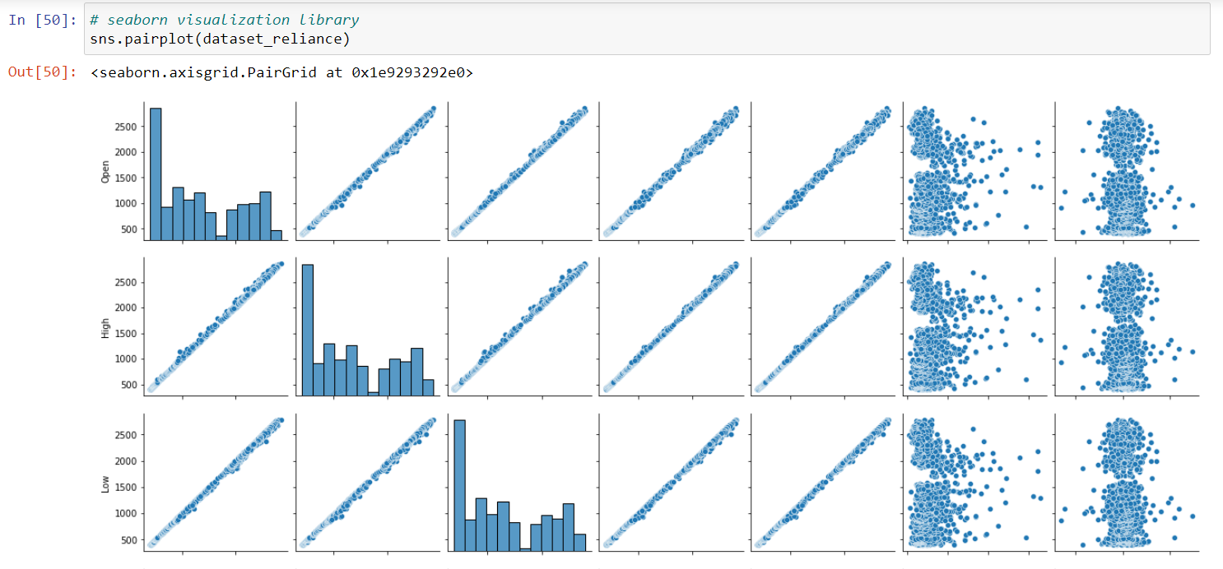
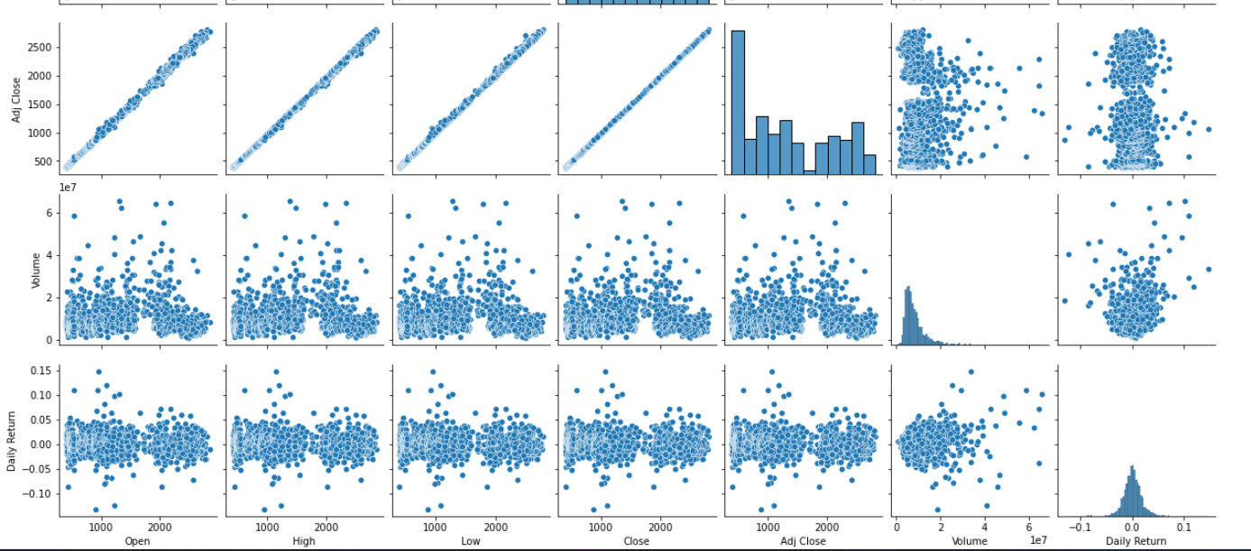
Seaborn library

Slide 9
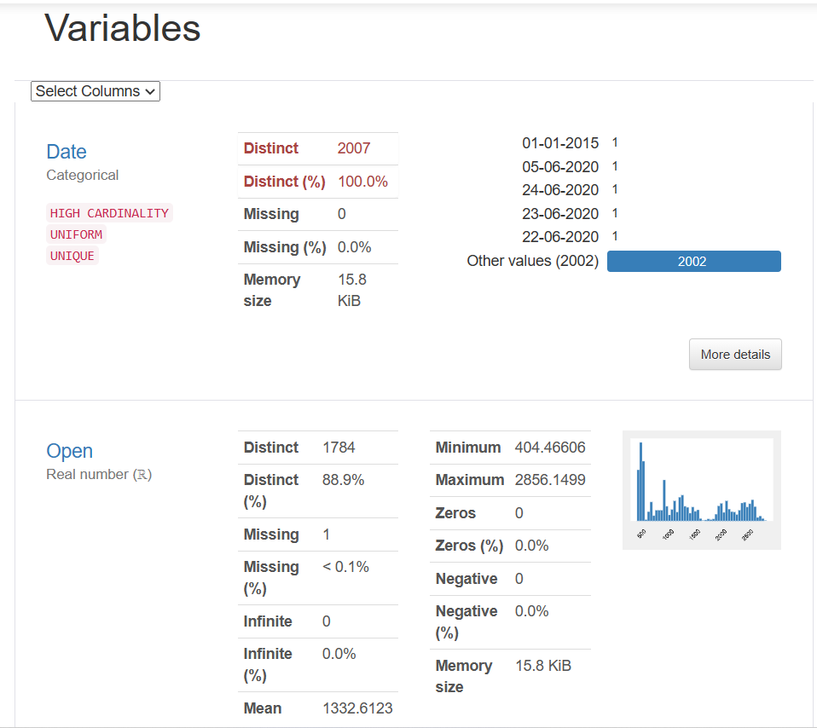
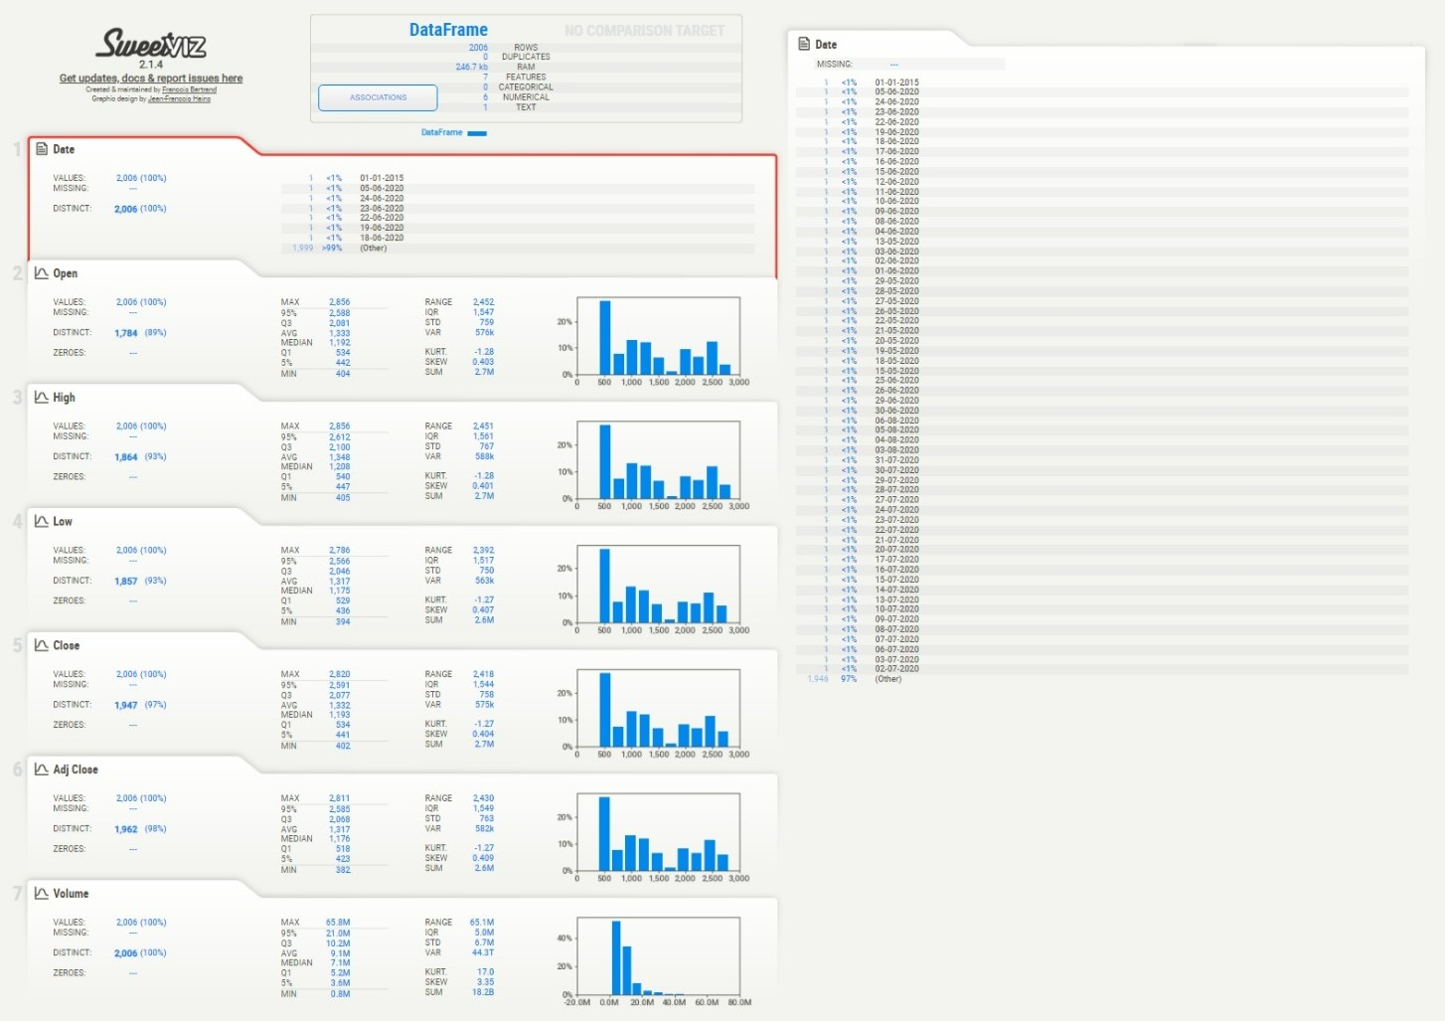
EDA
PANDAS PROFILING
SWEETVIZ

Slide 10
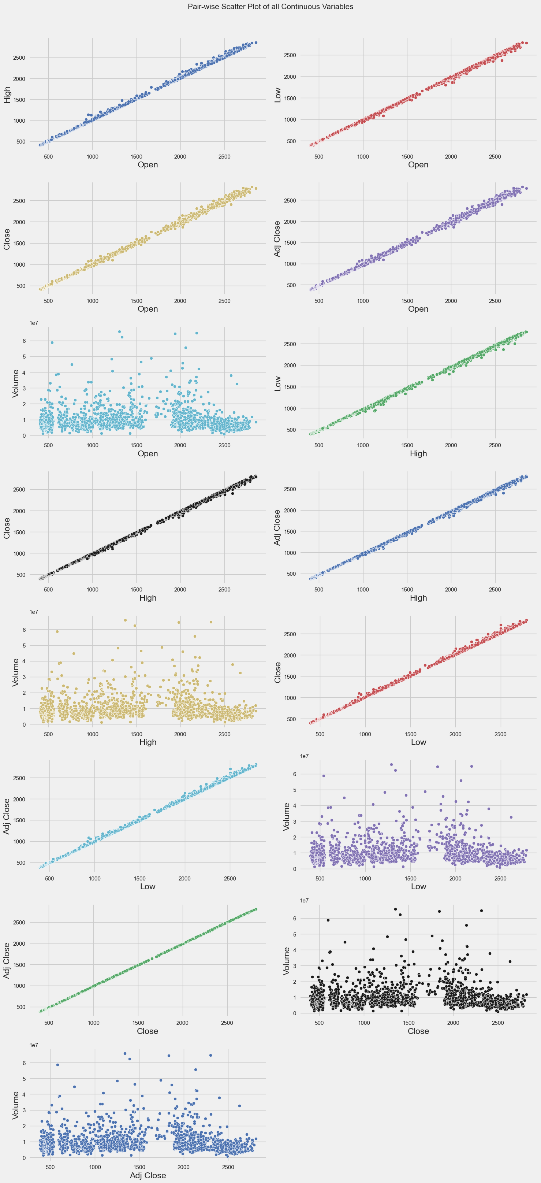
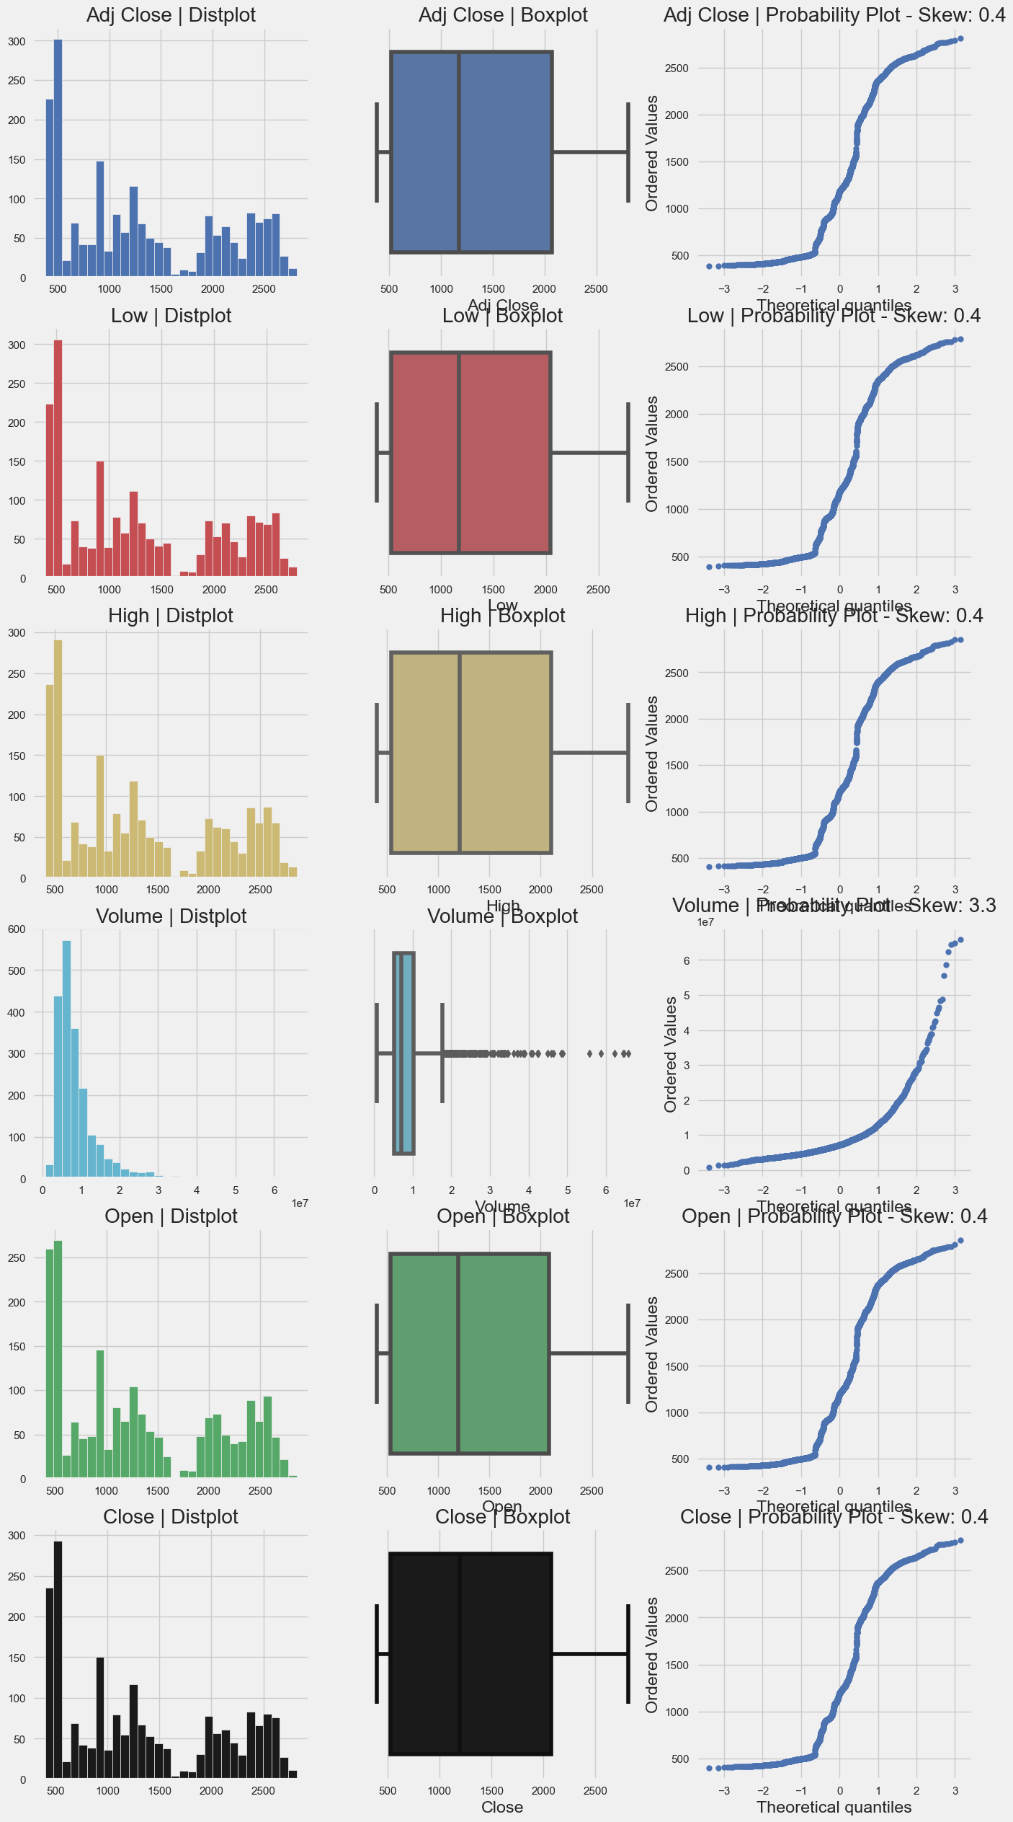
AUTOVIZ

Slide 11
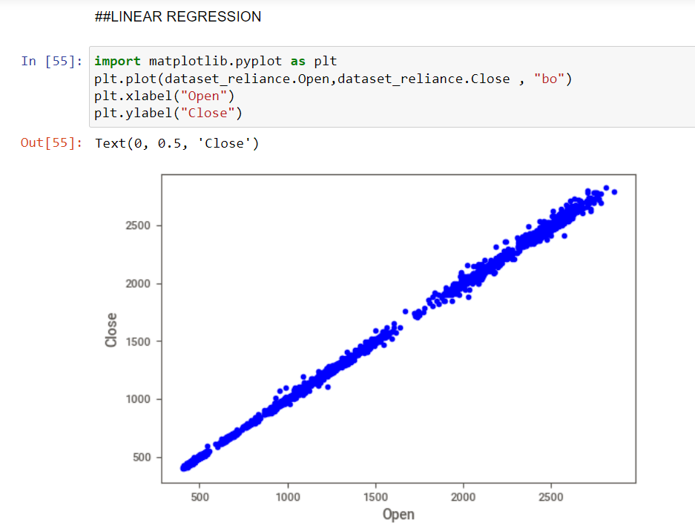
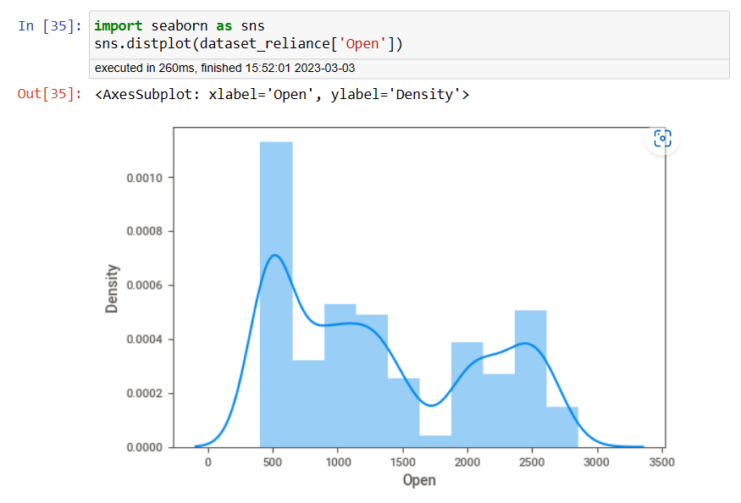
Linear Regression Model

Slide 12
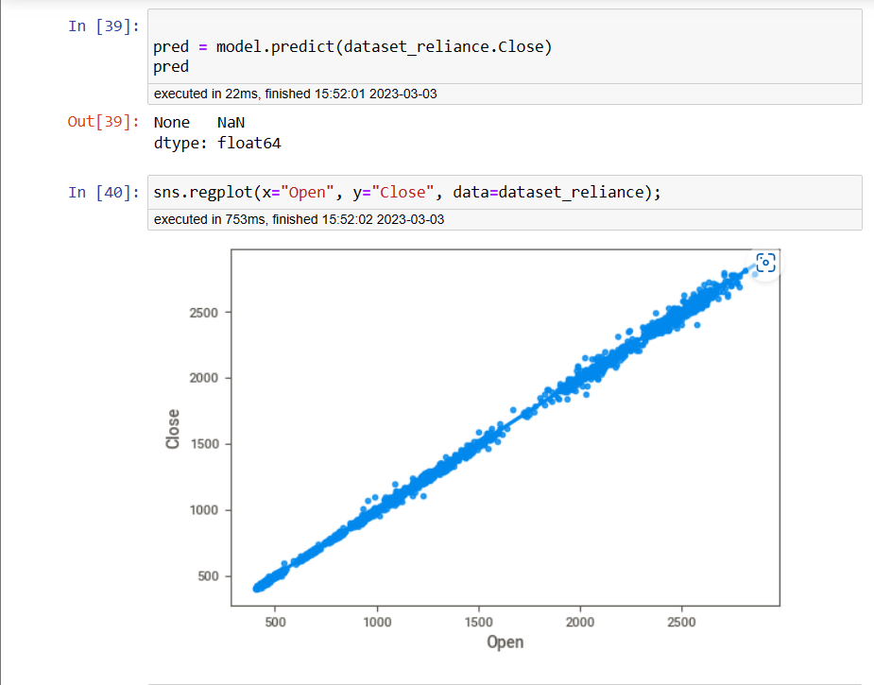
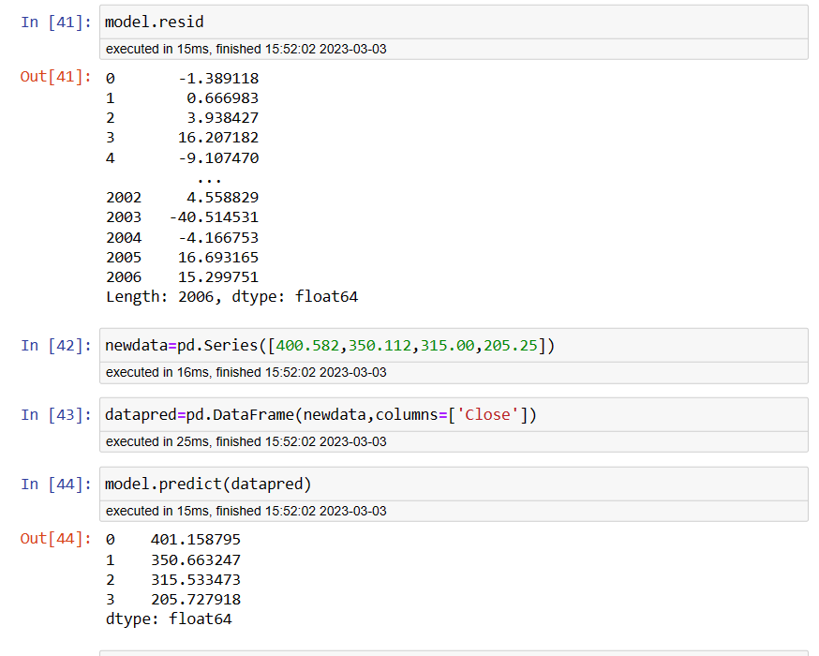

Slide 13
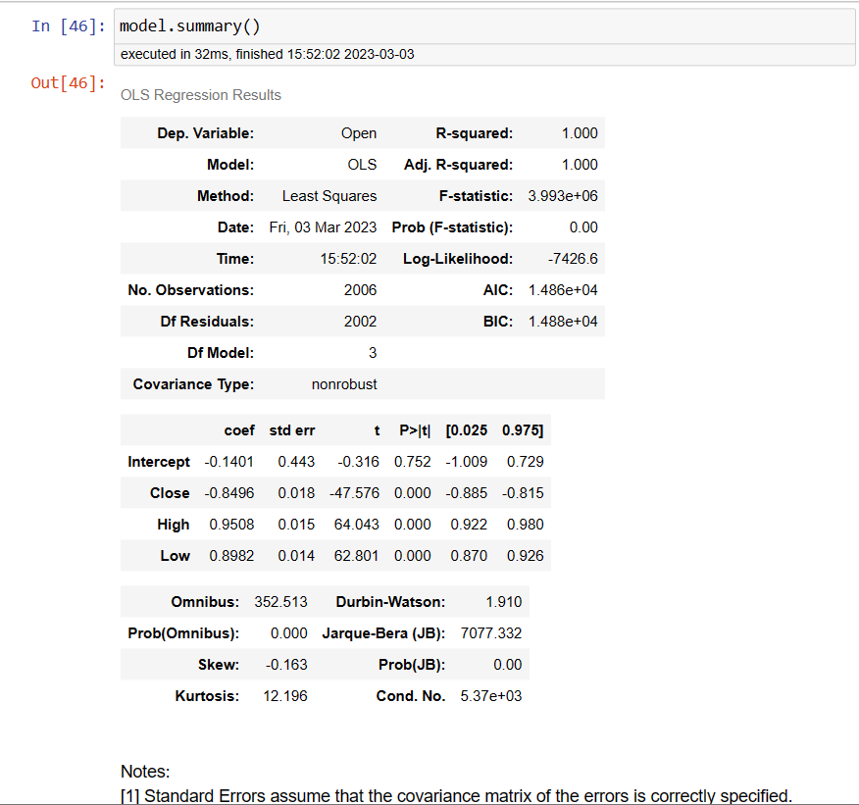
Multi Linear Regression Model

Slide 14
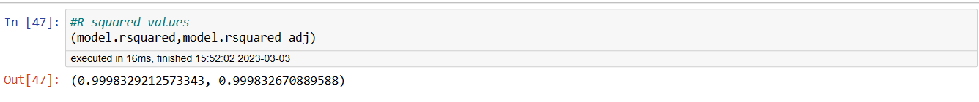

Slide 15
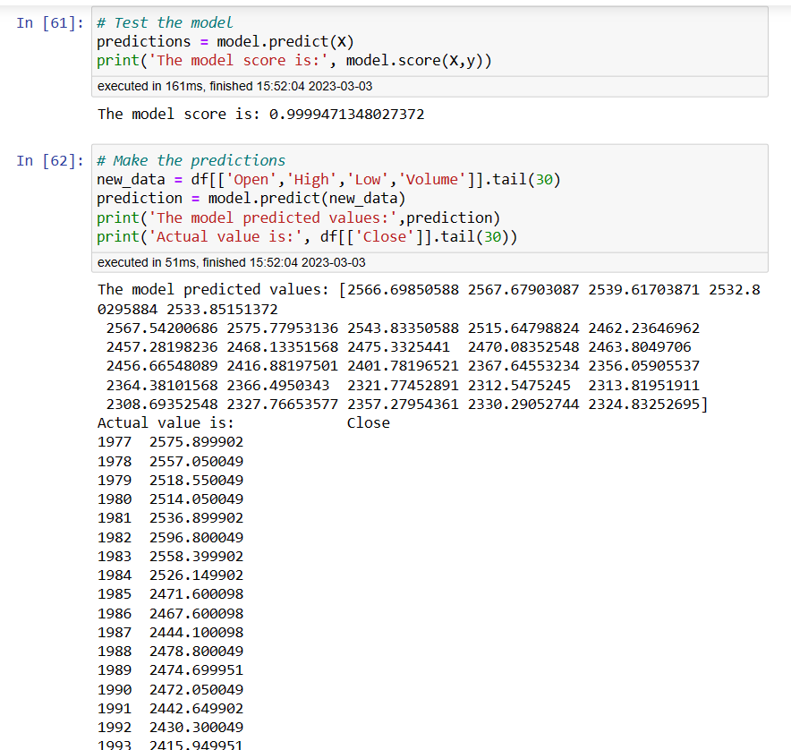
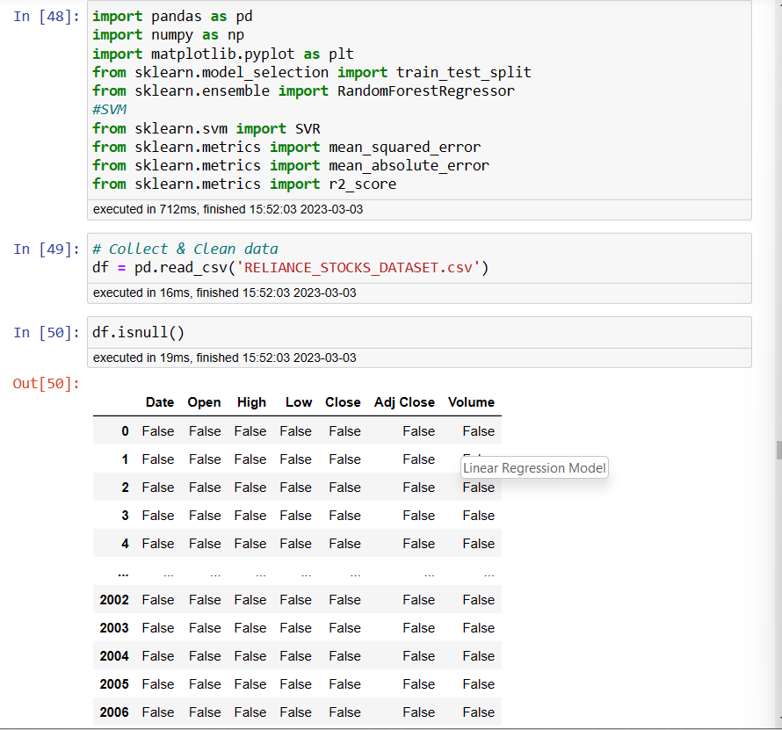
Random Forest

Slide 16
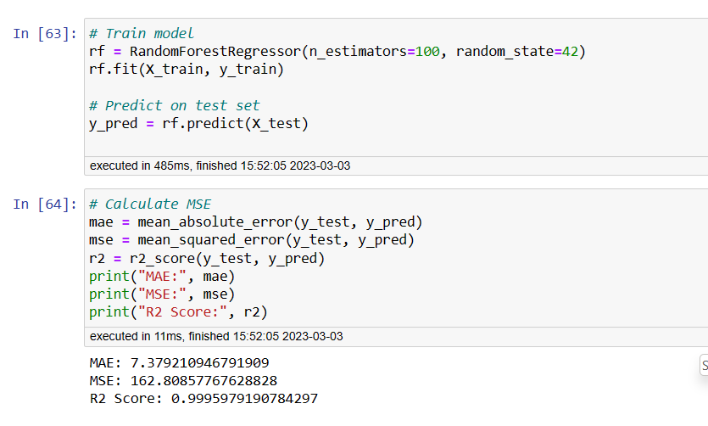
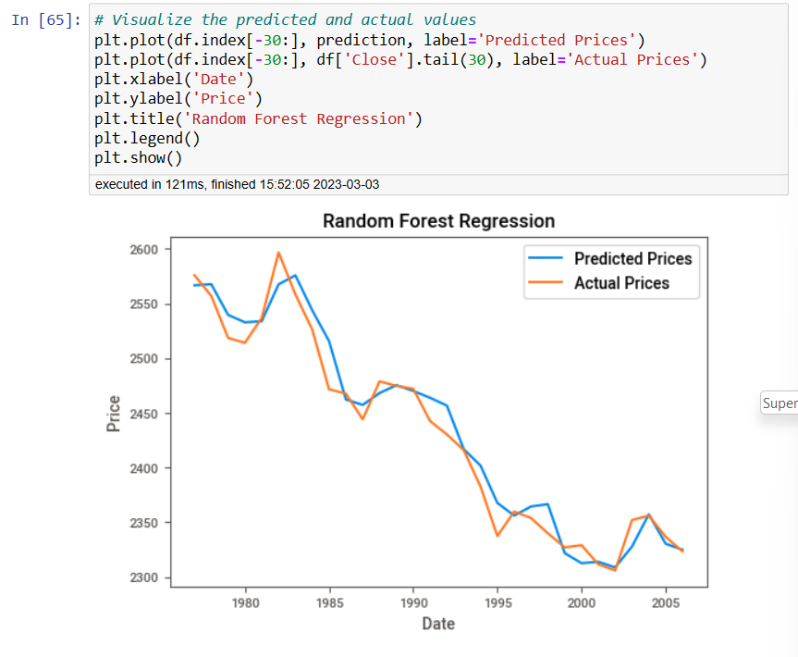

Slide 17
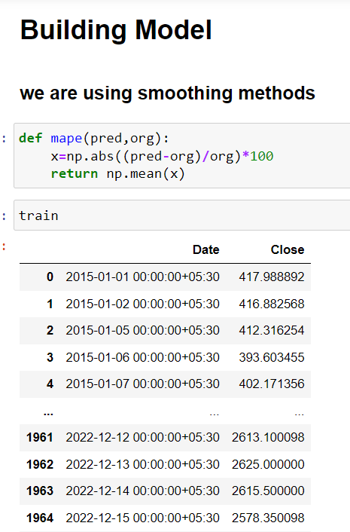
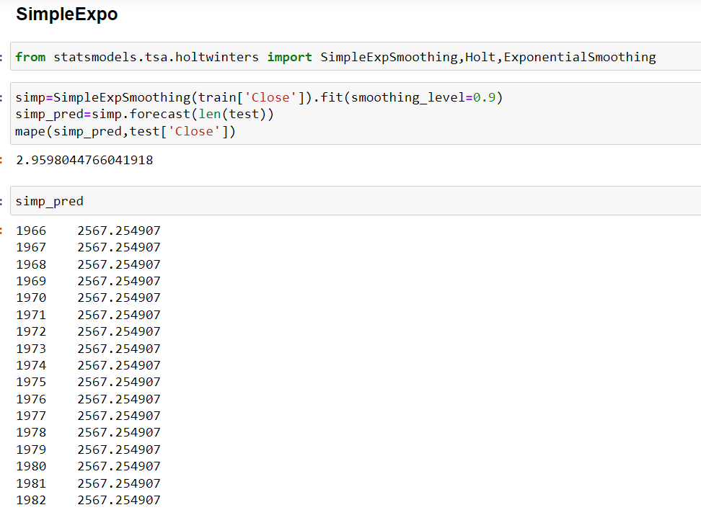
Simple Exponentials Smoothing

Slide 18
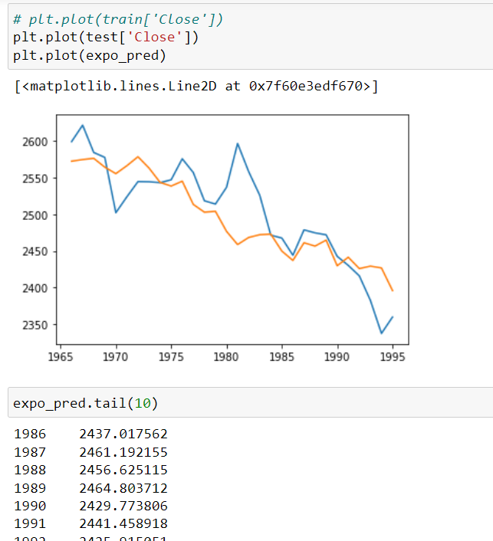
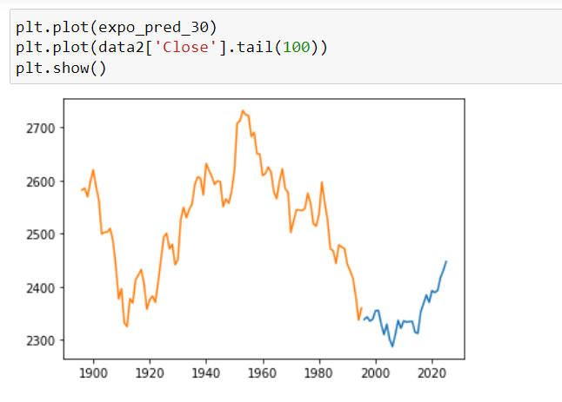
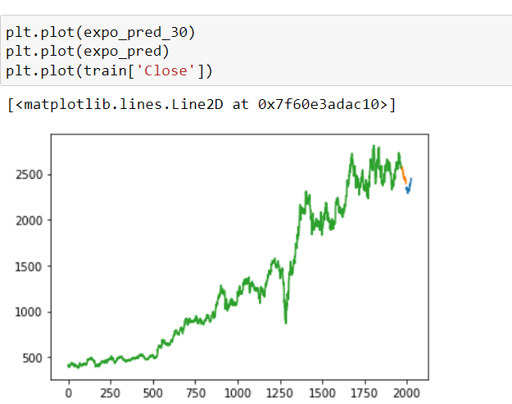

Slide 19
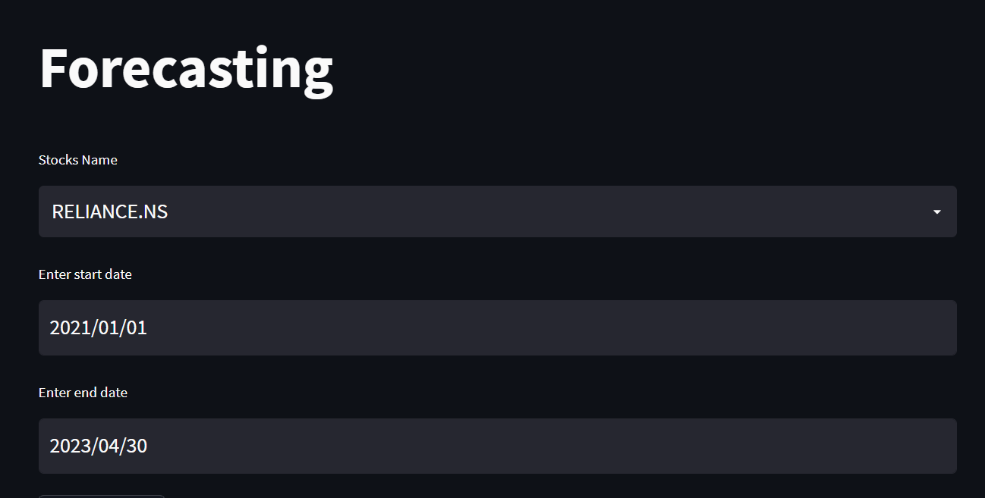
Deployment
We have used streamlit for deployment.
We have selected SES (Simple Exponential Smoothing) model for deployment.
Select the end date which you want to see the forecasting
Then click on apply to get the visualizations and then click on forecast to see the result.

Slide 20
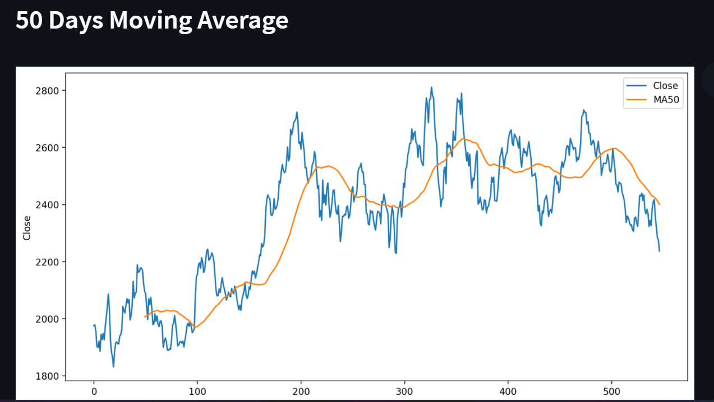
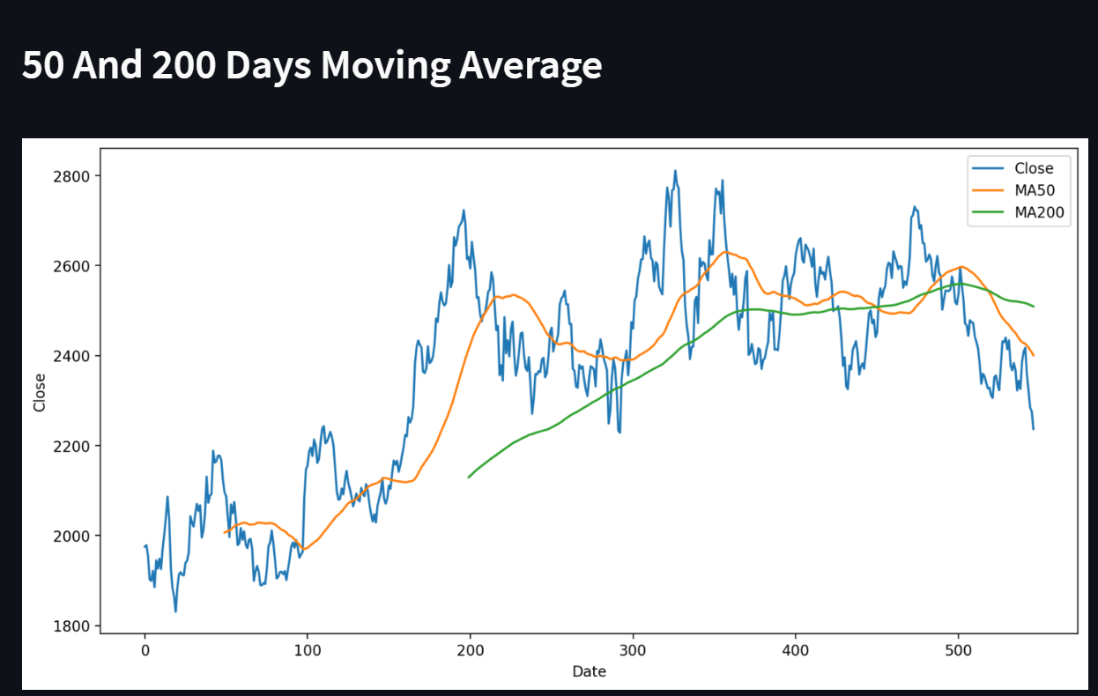
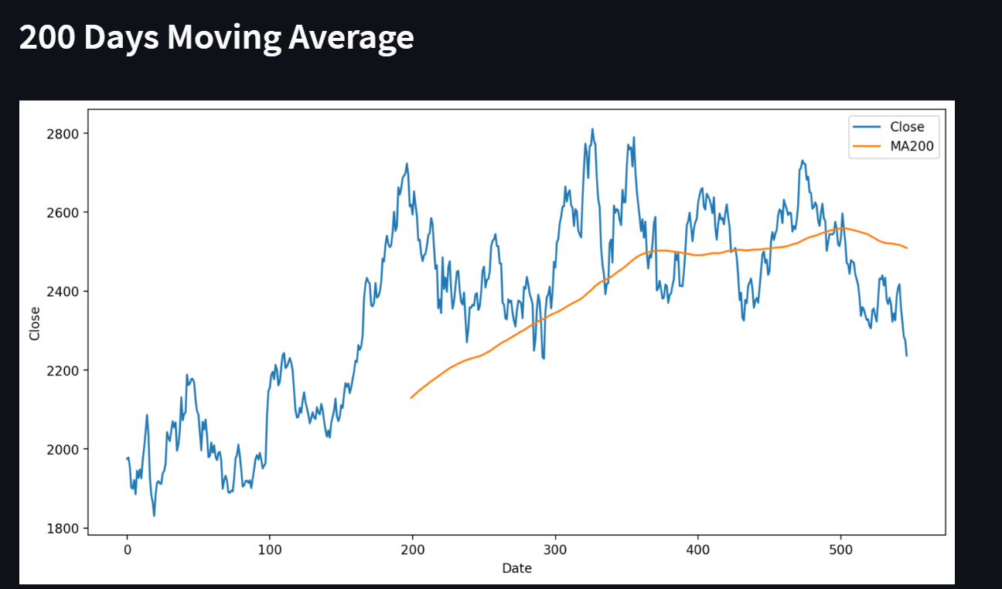
Visualizations

Slide 21
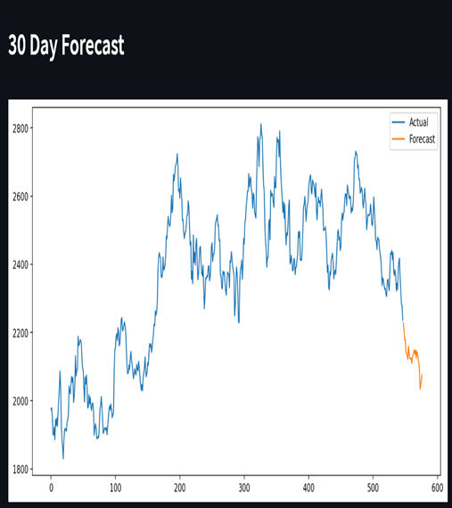
We will get 50 and 200 days moving average And finally we get the forecast for the selected dates.

Slide 22
Challenges :
Faced some issues while dealing with dataset.
Dealing with null values
Converting date column into date format (%y-%m-%d) otherwise it will give error while running the code.
First we have done the linear regression model but at deployment it was giving error. So we have selected other model.

Slide 23
Thank You

